Slide 1
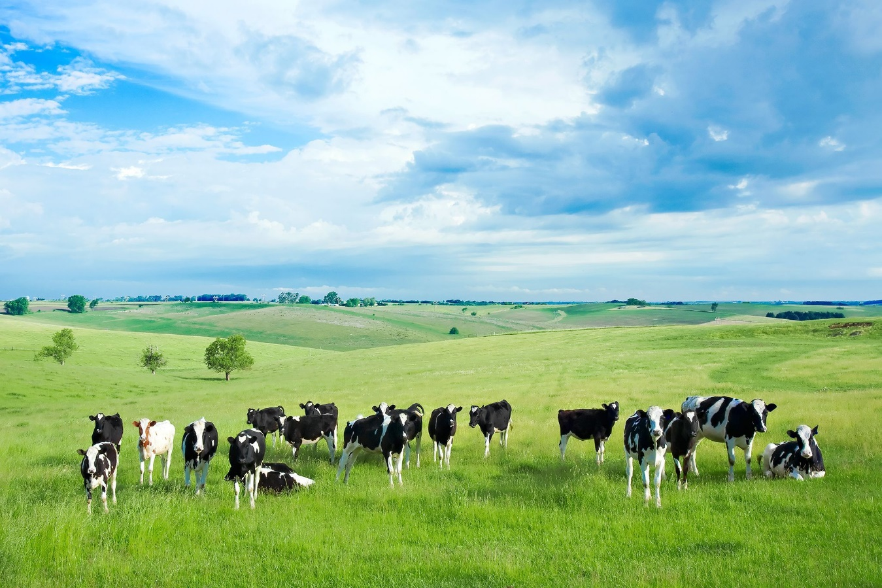
Project: Farm Together
SUBMITTED BY ,
Ahasanul Bari Rifat
UG02-47-18-0007
DEPARTMENT OF CSE
SUBMITTED TO
KHAN Md. HASIB
LECTURER DEPARTMENT OF CSE

Slide 2
OUTLINE
1. INTRODUCTION
2. Flow chart
3. Technology
4.Diagram
5. Future improvements and plan

Slide 3
INTRODUCTION
An investment farm is an agricultural business operation that is
purchased and operated with the intention of making a profit,
or with the goal of creating a tax deduction for the owner.
Agribusiness is the business sector encompassing farming and
farming-related commercial activities.

Slide 4
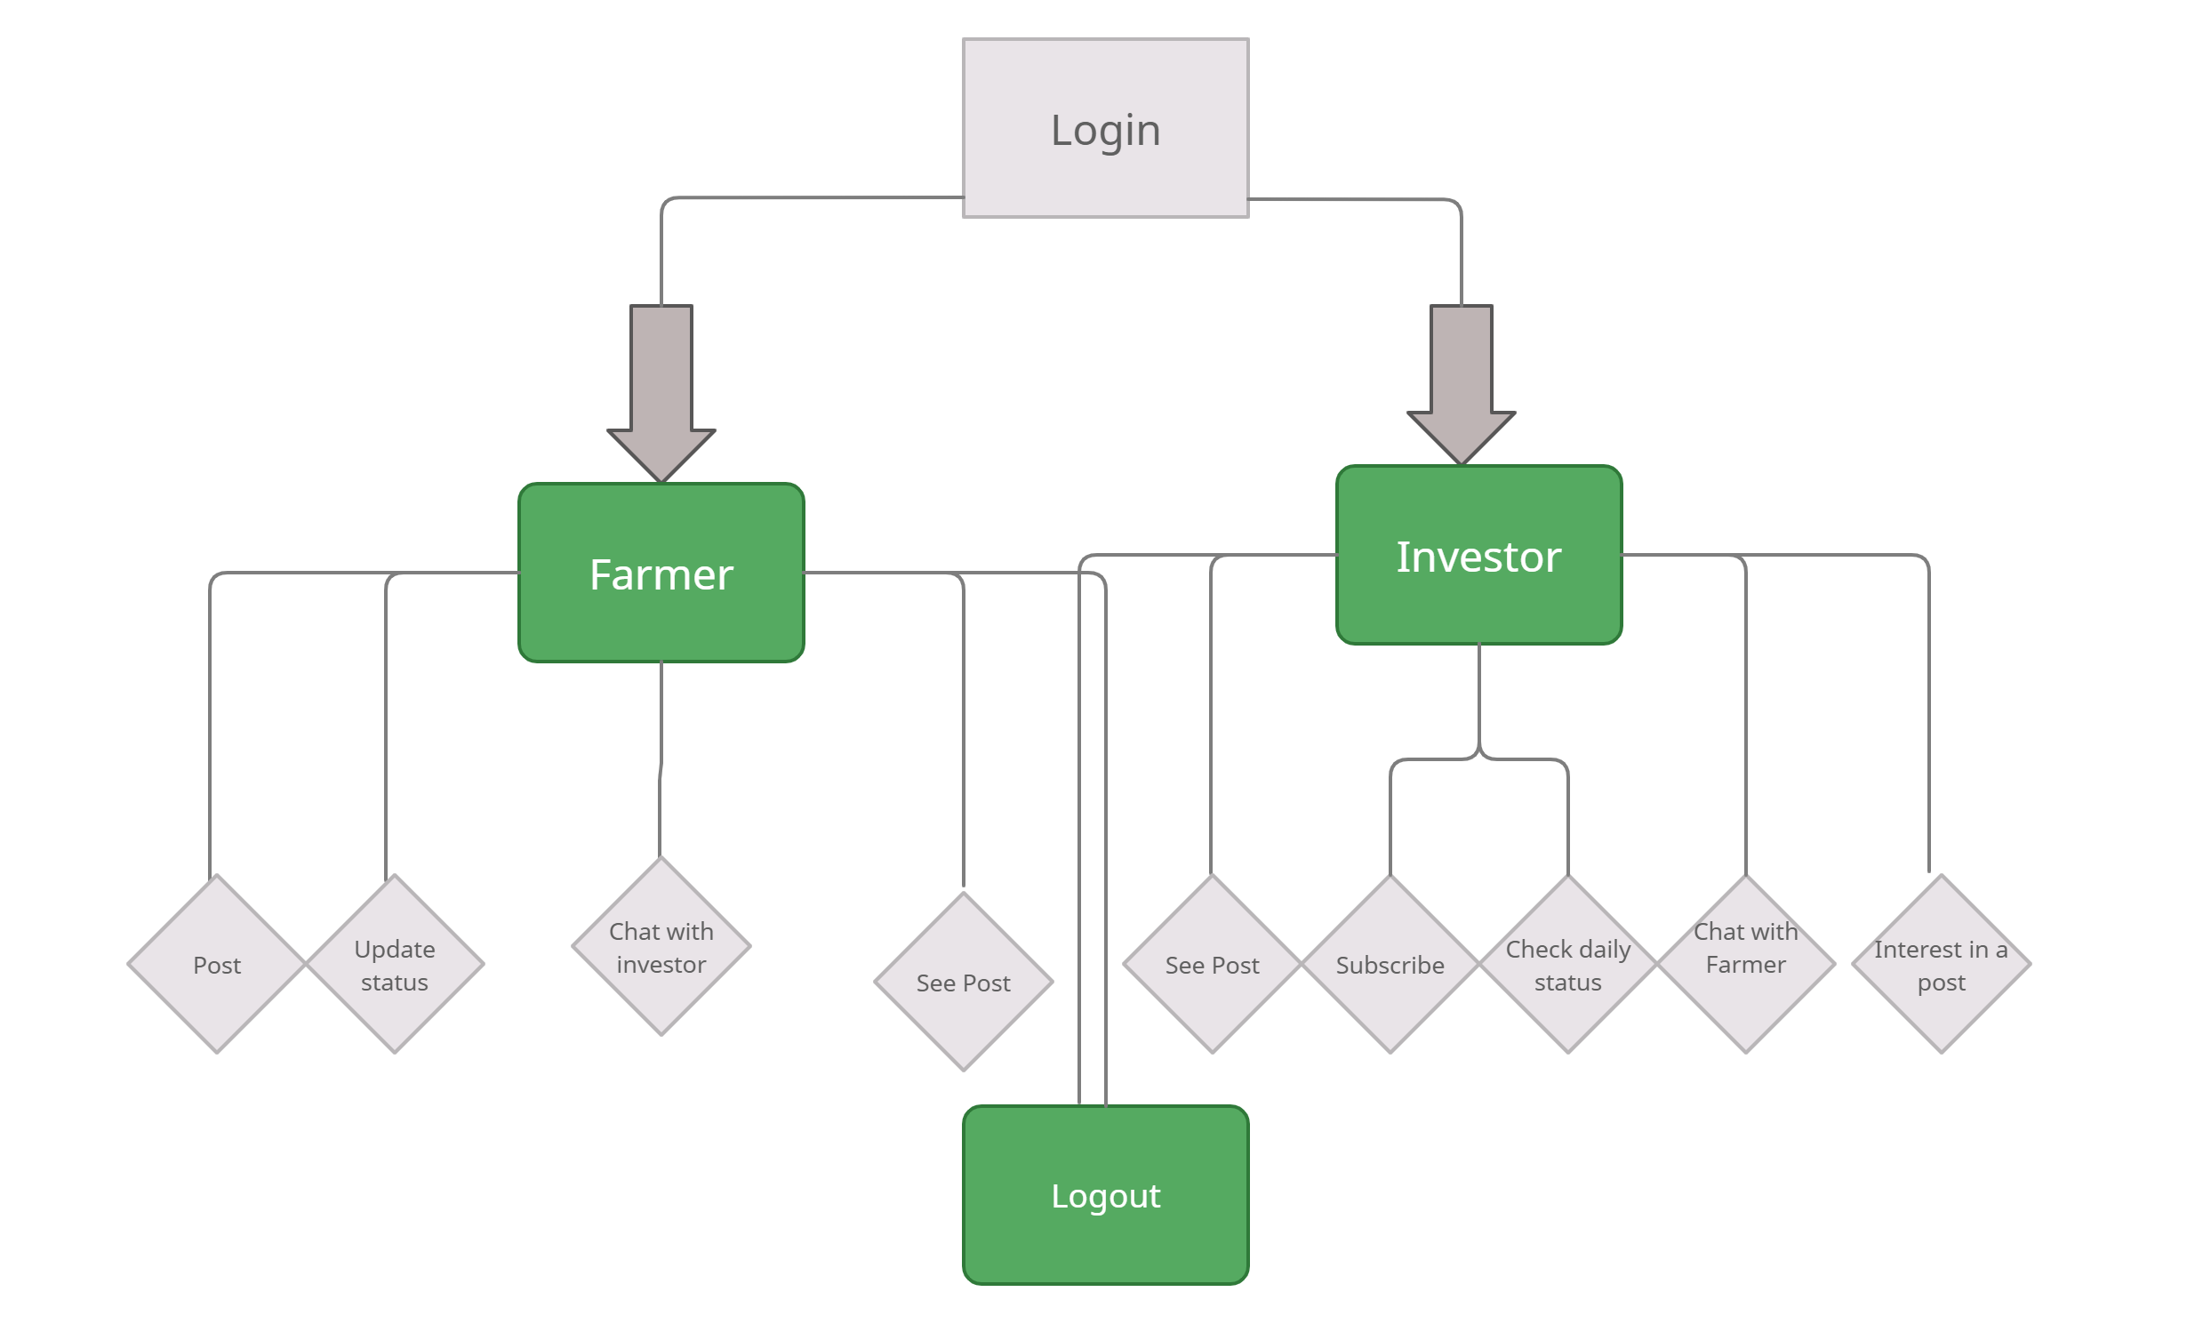
Flow chart

Slide 5

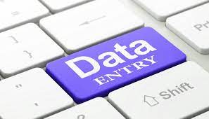
Others Features
Communications Between Farmer And Investor:
Daily Status:

Slide 6
Technology
HTML
PHP
CSS
MYSQL

Slide 7
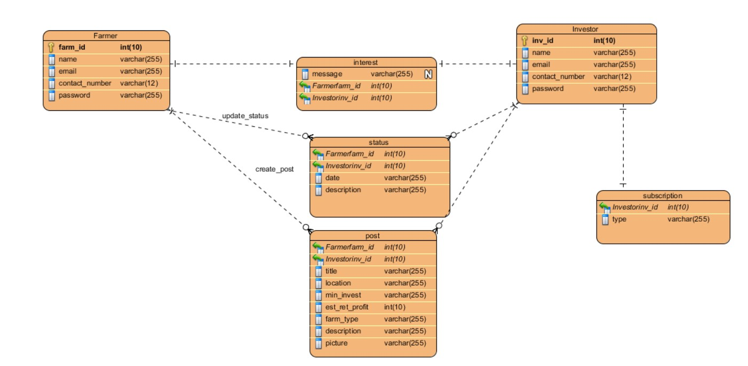
ERD Diagram

Slide 8
Future improvements and plan
Buy Products
Appointing Agents

Slide 9


